Slide 2
Kelly Gray
I am a 20 year SAS user who loves manipulating data. I have a degree in Journalism from the University of North Carolina at Chapel Hill, and a Certificate in Computer Programming from North Carolina State University. I've worked in Technical Support, Education, Sales, and Marketing and love sharing my knowledge of programming and reporting using SAS.

Slide 3
20 in 20: Quick Tips for SAS Enterprise Guide Users
Kelly Gray, SAS Institute

Slide 4
Customize Options!

Slide 5
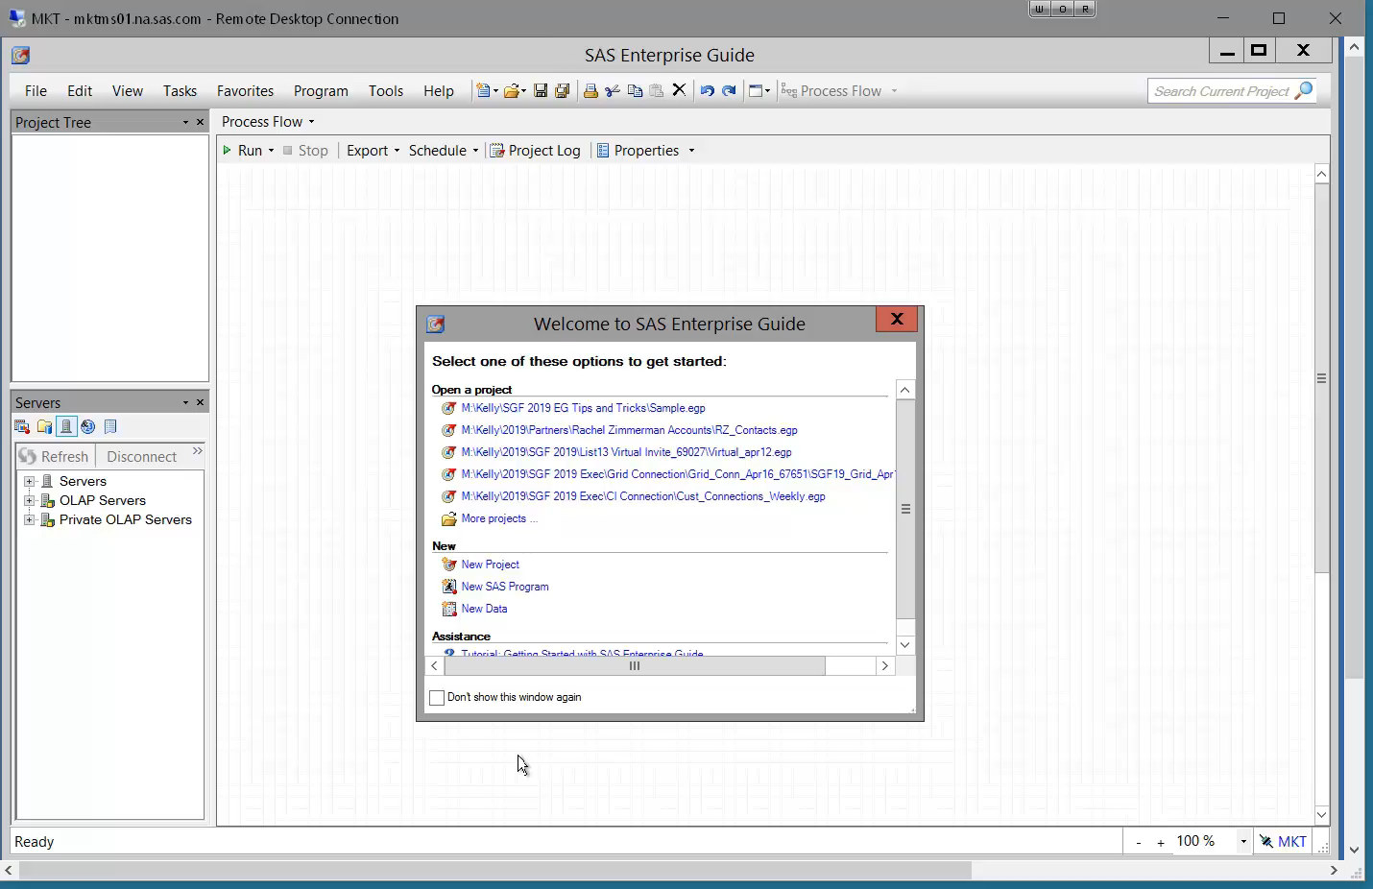
1. Turn Off Welcome Window
Notes:
Click selection box on window
OR
Tools → Options → General
Close project, reopen, NO WINDOW!

Slide 6
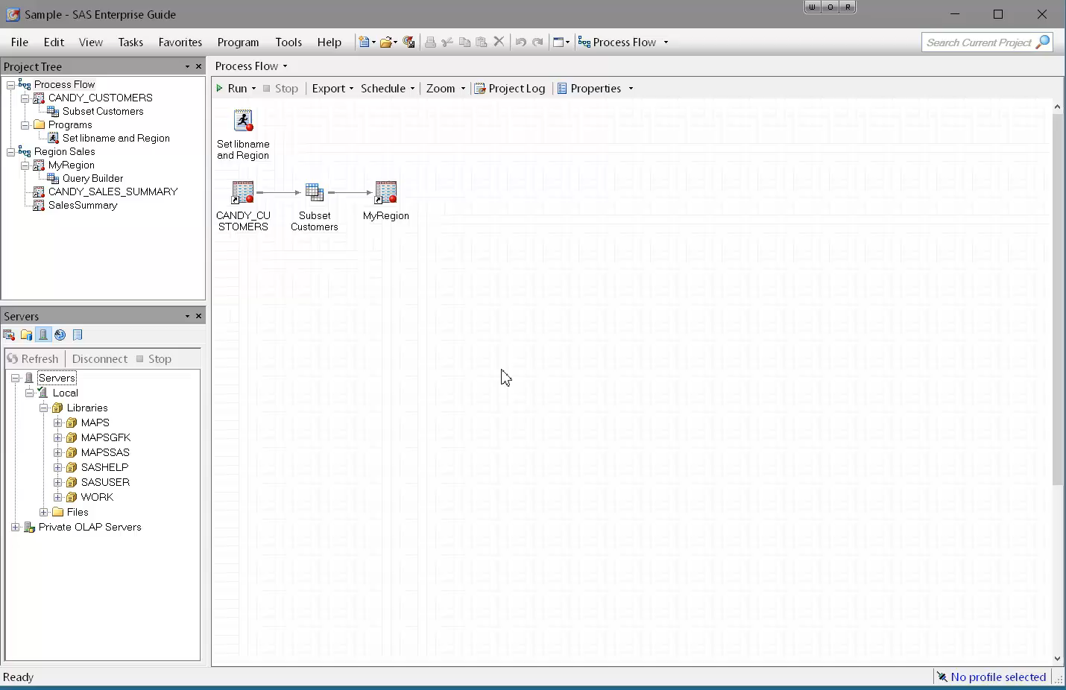
2. “Autoexec” Process Flow
Notes:
Automatically runs the process flow WHEN OPENING PROJECT
Could use to define datasets used in the project, libraries, macros, etc.
Name the process flow you want to run to “Autoexec”
Save the project
Close, reopen project
Select that you want to run autoexec when prompted
Check to make sure the library was created and assigned
Can force it to run automatically via tools → options → General → “ Automatically run autoexec process flow when project opens”

Slide 7
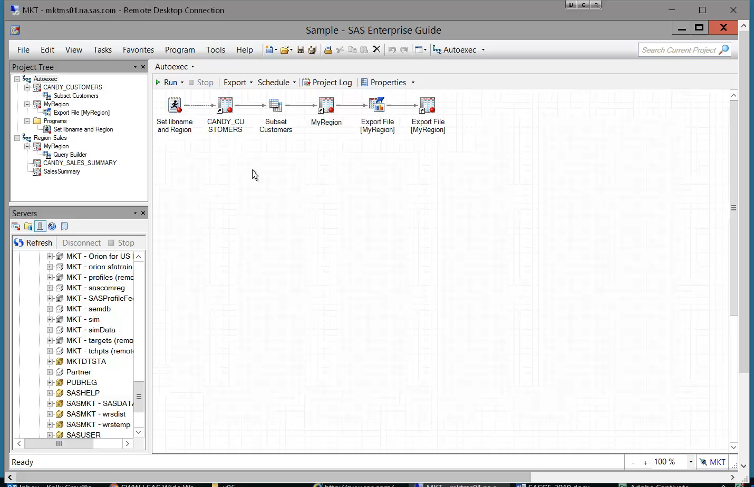
3. Split View into Multiple Windows
Notes:
FAVORITE tip
Stacked OR Split
Can use to view code and log or results at the same time

Slide 8
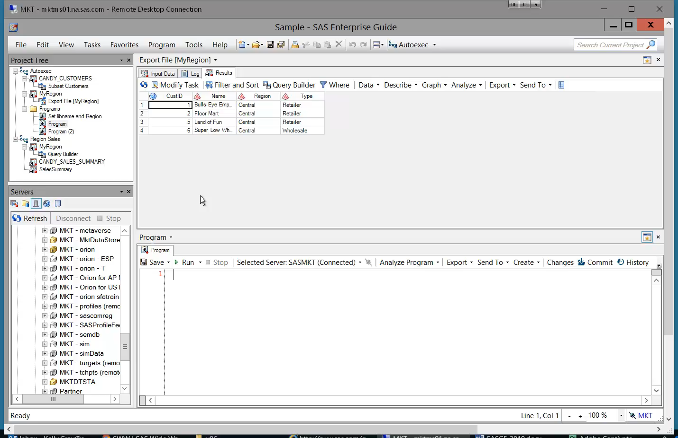
4. Reset Default Layout
Notes:
A lot of ways to customize the layout of the project……can sometimes be hard to get it “reset” if you want to change things
Use Restore Window Layout to “find” missing windows, if a mouse is behaving badly, or you just want to start over
Tools → Options → General → Restore Window Layout

Slide 9
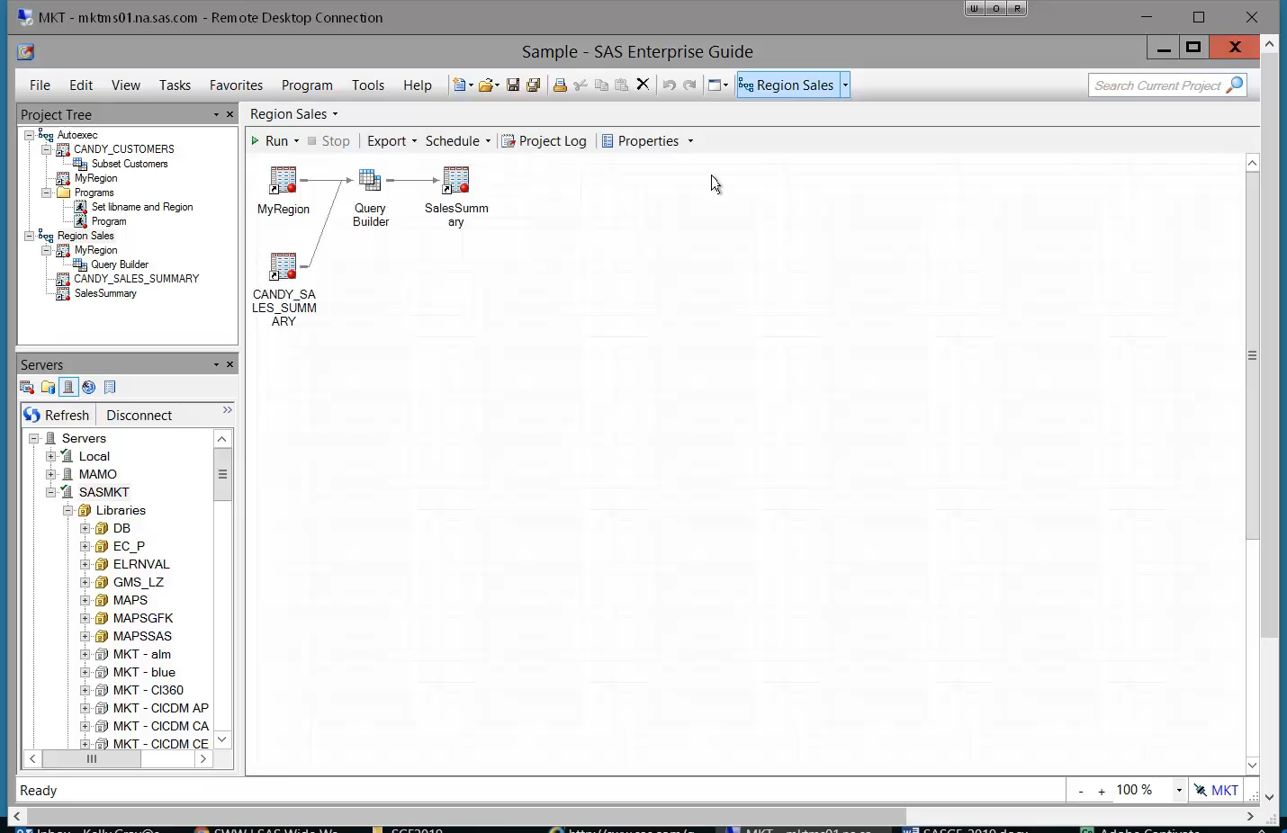
5. Automatically Replace Task Results
Notes:
Save a step from having to choose “yes” each time
Tools → Options → Results : “Prompt before replacing” is default
Do not replace
Replace without prompting

Slide 10
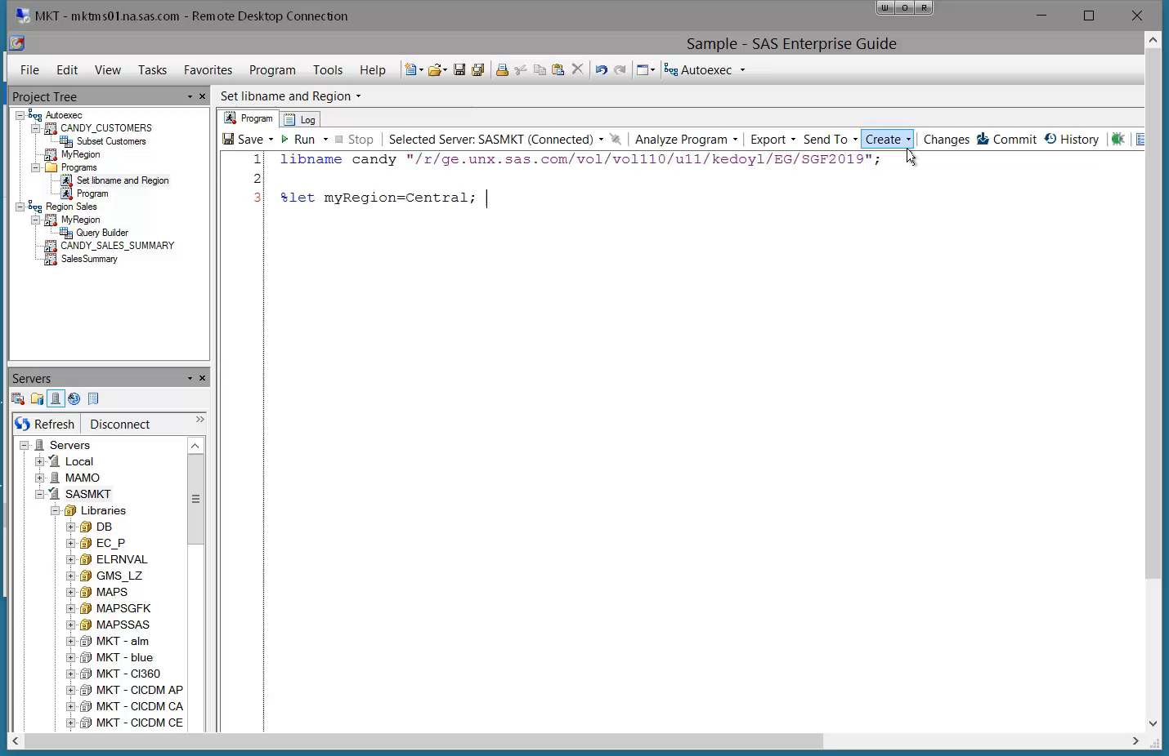
6. Automatically Submit Custom SAS Code
Notes:
Can use to have libnames assigned, macros created, etc WHEN SERVER IS CONNECTED
Tools → Options → SAS Programs : Submit SAS code when server is connected
Disconnect server
Reconnect – CANDY library is there and assigned

Slide 11
Program Editor!

Slide 12
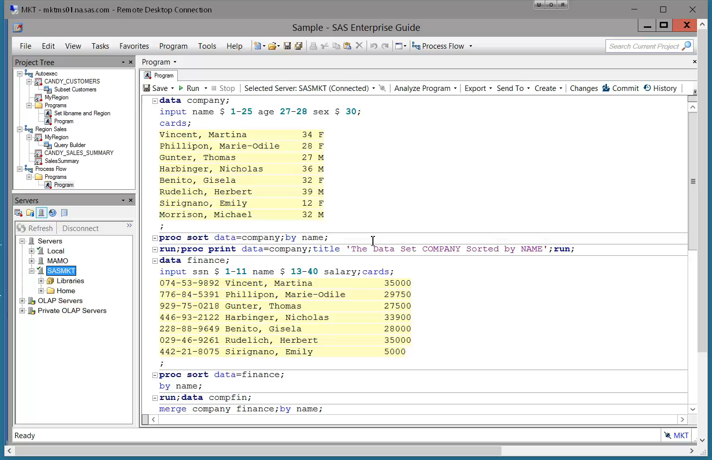
7. Turn on Line Numbers
Notes:
Helpful for debugging
Tools -> options -> SAS Programs → Editor options

Slide 13
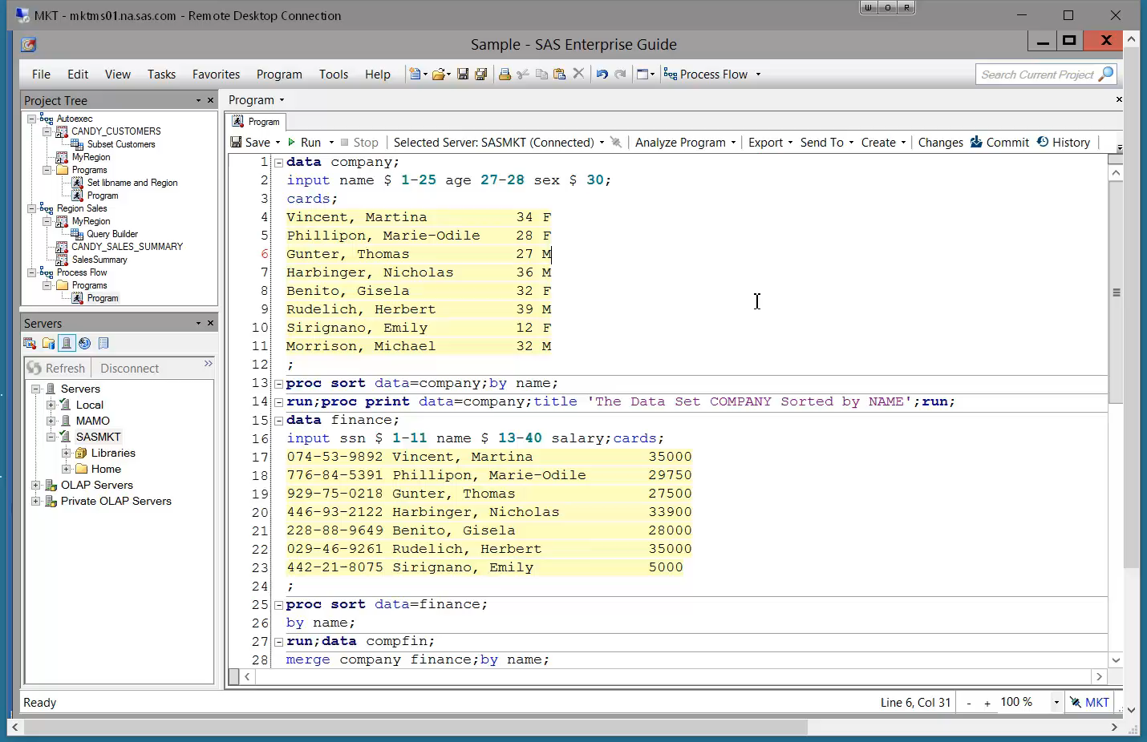
8. Automatically Format Code
Notes:
Time saver for when you’re being a lazy coder
Edit → Format Code
OR
Right click → format code

Slide 14
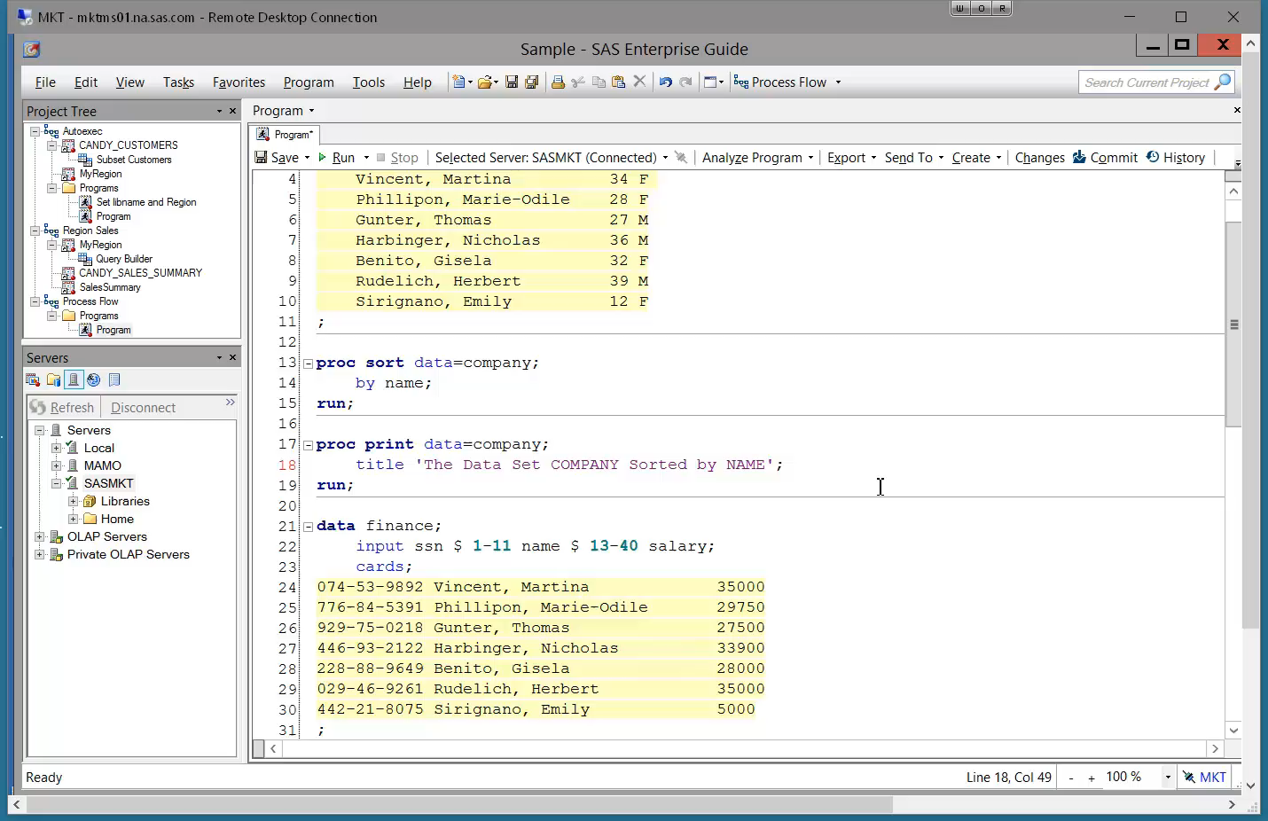
9. Copy a Column
Notes:
Time saver
Left mouse and ALT
Saved us from rewriting 7 lines of data

Slide 15
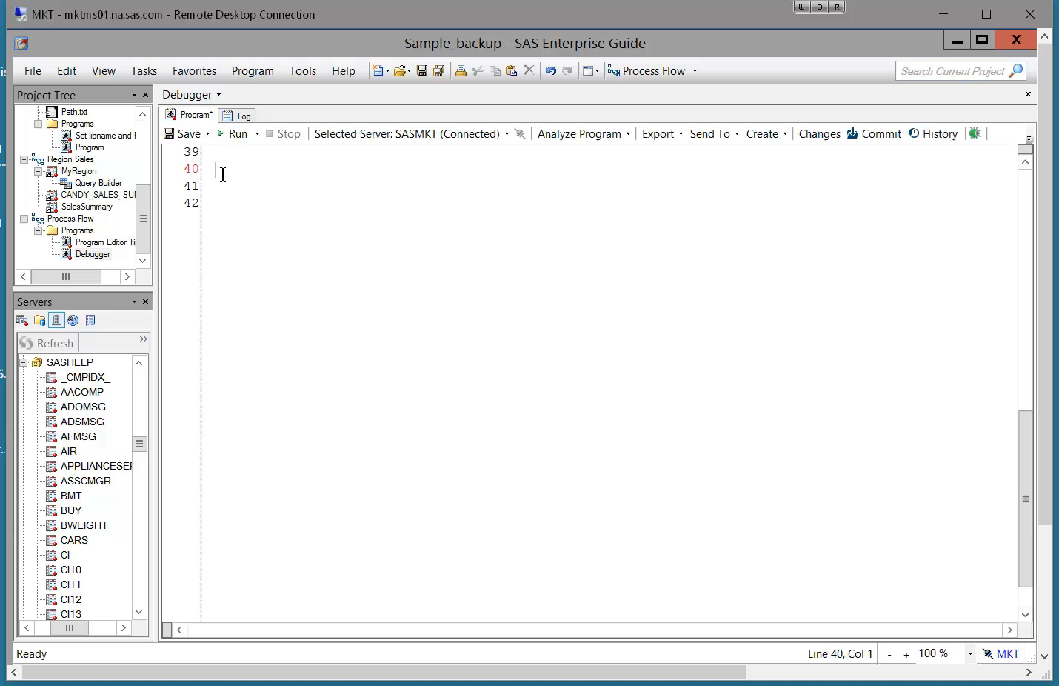
10. Autocomplete
Notes:
Suggests valid options for syntax, or libraries, or datasets, variables, etc
If you find it distracting, you can customize it or turn it off via
Tools →Options → sas programs → editor options → autocomplete tab
Customize, or disable it

Slide 16
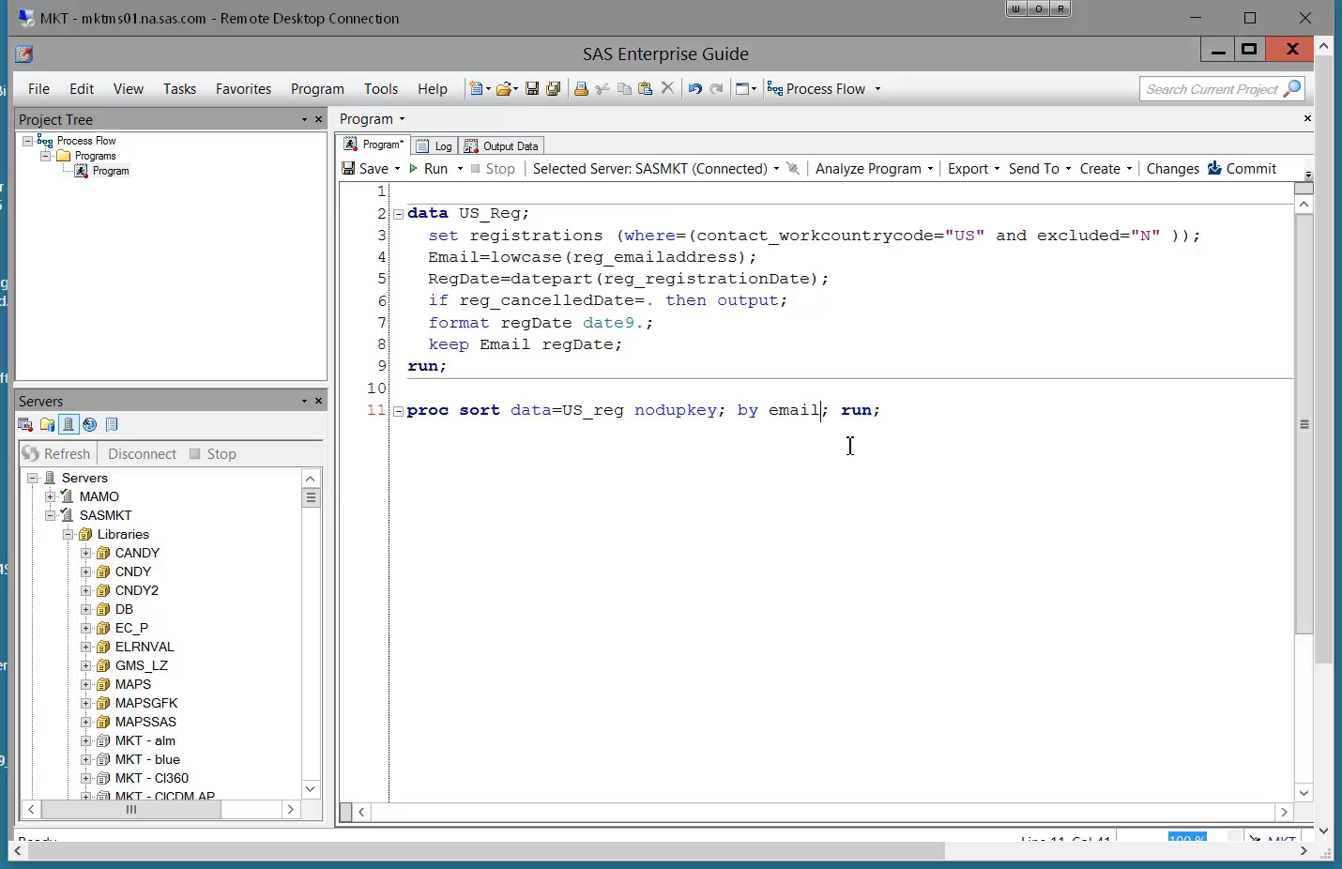
11: Abbreviation Macros
Notes:
Timesaver for inserting code that you run often
Select and copy code
Program → Add Abbreviation Macro → type abbrev (REG) → paste code
Type “Reg” in the editor (select with autocomplete), code is inserted

Slide 17
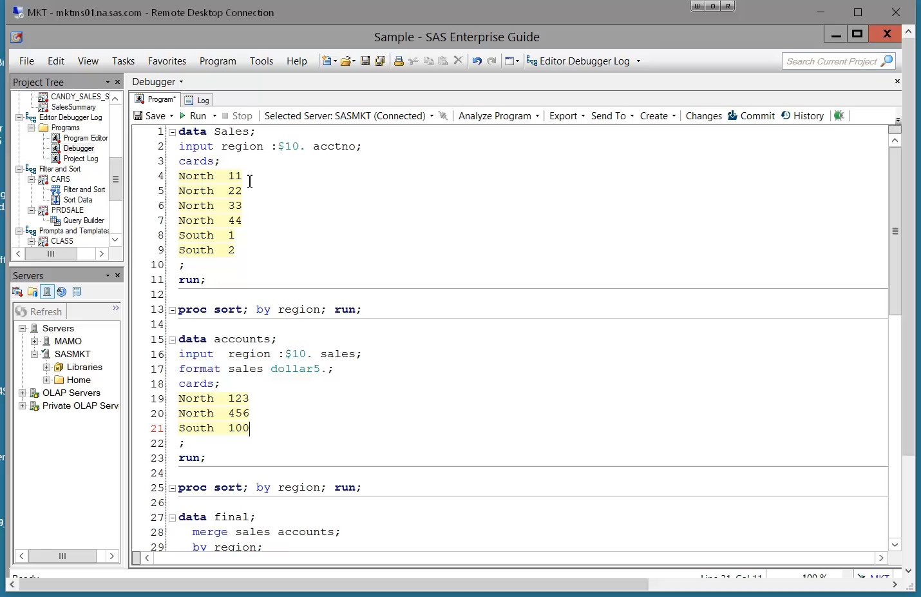
12. Data Step Debugger
Notes:
Helpful for figuring out logic errors
Here we aren’t getting the expected results from a merge
Turn on the debugger
Step through merge code – set Watch variable of Sales
See value change – Ah, it’s because the variable is not reset to missing until the by group changes.

Slide 18
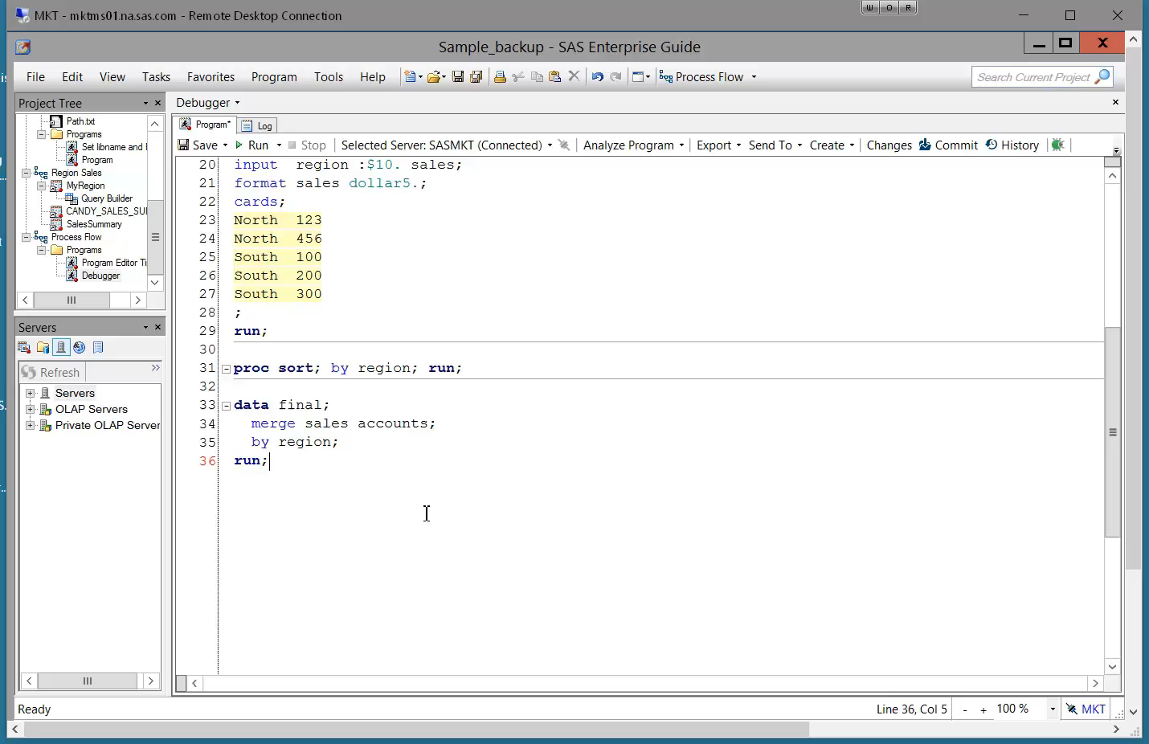
13. Syntax Help Window
Notes:
Gives you syntax help
Quick access to product doc, samples & sas notes, and papers
See keyboard shortcuts in paper

Slide 19
Logs!

Slide 20
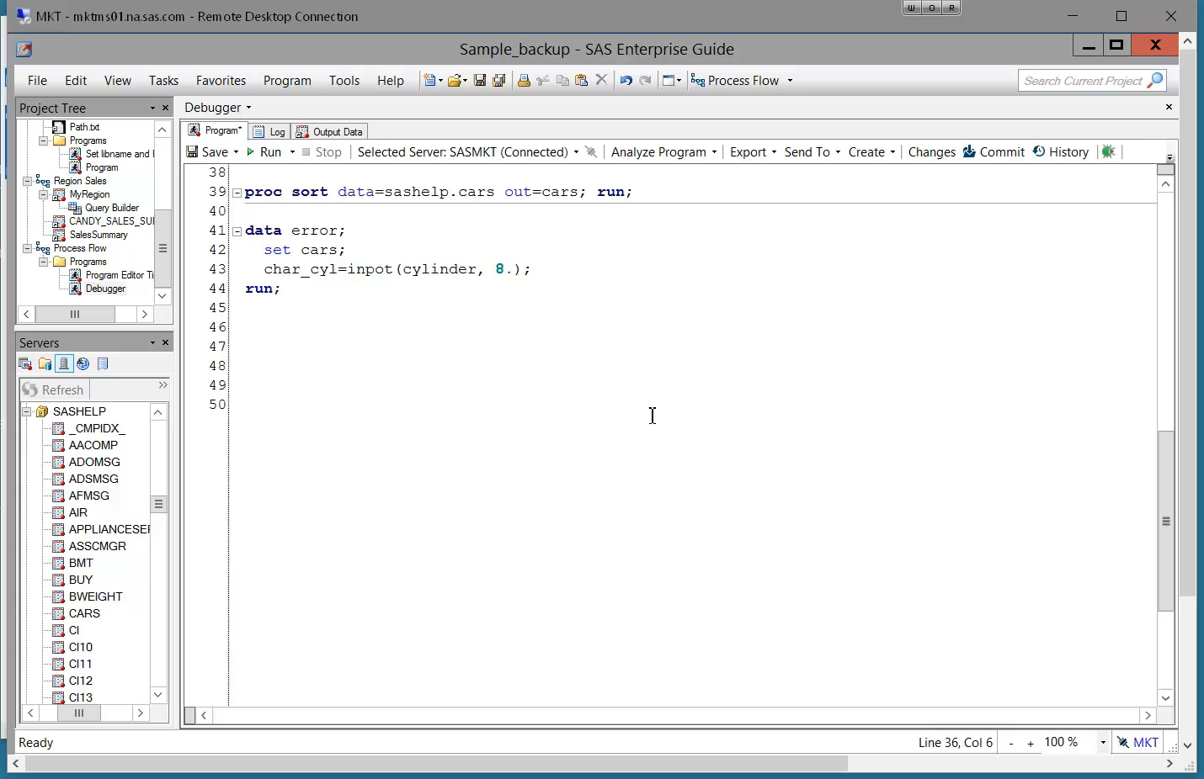
14. Enable Project Logging and Find Errors
Notes:
Way to track all the tasks and code run in the project and enable you to view the logs all in one place
Tools → options → General → Enable project log for new projects
Run the code, see an error in the log
Look at log summary, expand the log for this run of the code
Remove warnings, notes
Click on error in log summary to jump to error

Slide 21
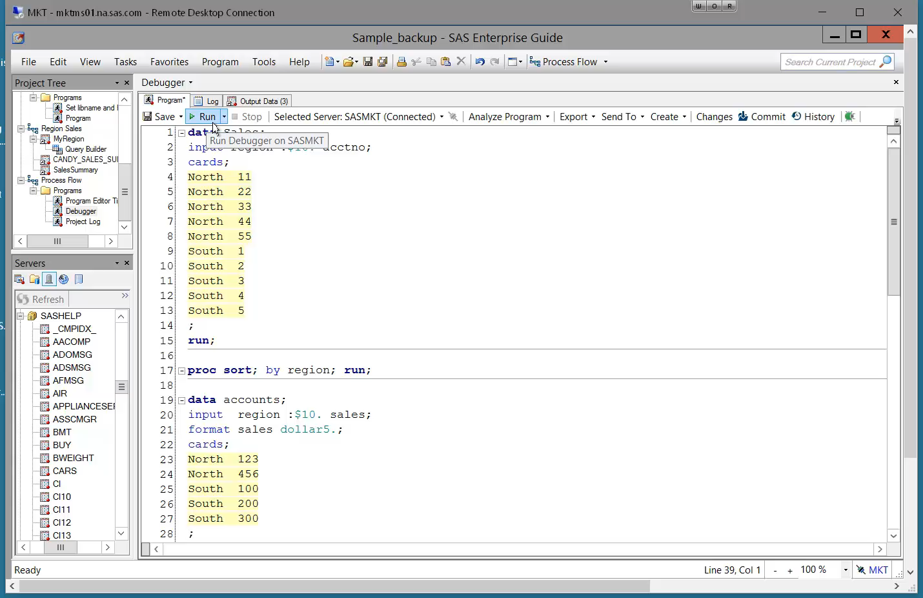
15. Declutter Log
Notes:
In EG, a lot of “noise” in the the log – wrapper code that contains macros and ods
Makes log hard to read
Tools → Options → Results General → “Show generated Wrapper code in log”
Log is cleaner

Slide 22
Tasks and Queries!

Slide 23
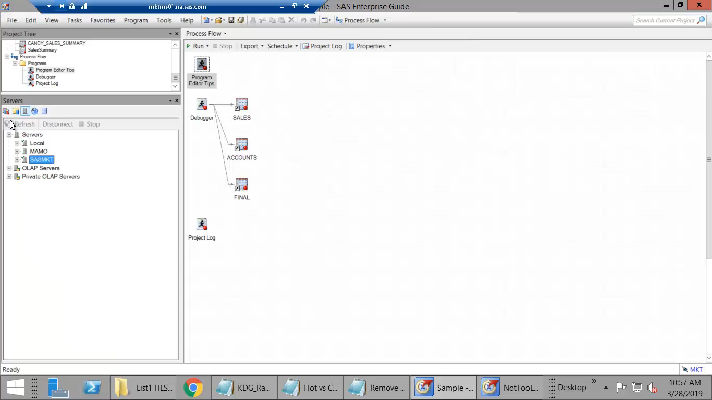
16. Find the Right Task
Notes:
EG Tasks run SAS Procedures behind the scenes – but what if you know the procedure you want to use but don’t know what task it maps to?
Task pane
Filter option, or search by name.
Hover over to get more info, select * to make it a favorite

Slide 24
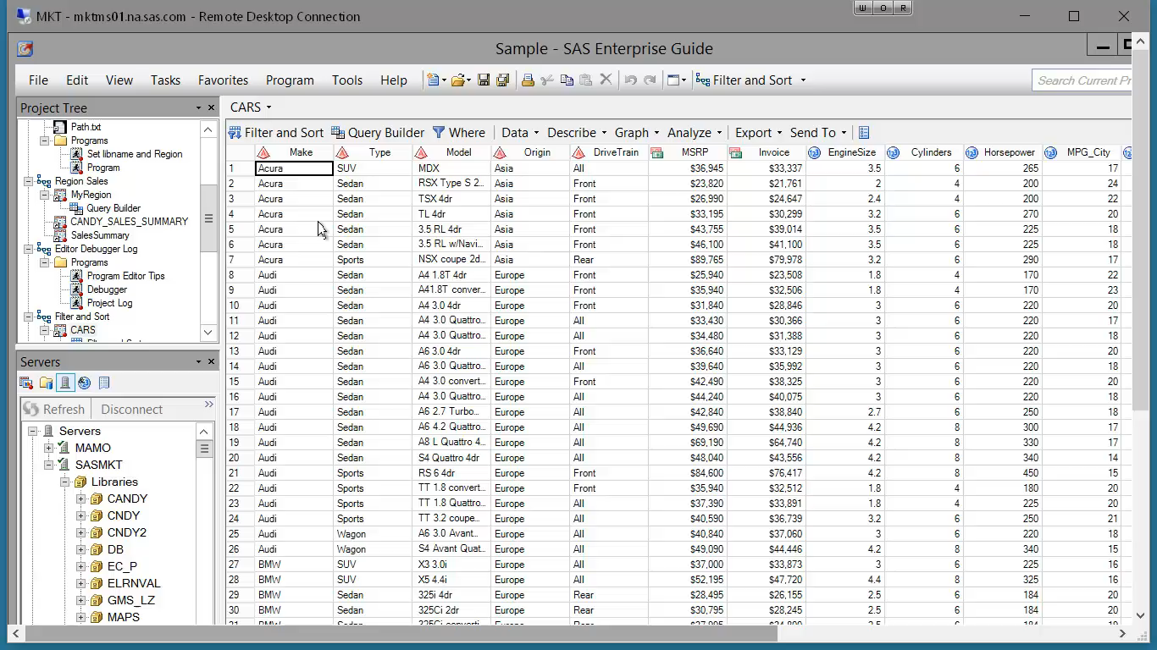
17. Filter and Sort
Notes:
2 tasks that let you sort – what’s the difference?
Filter & Sort: can not eliminate duplicates
Access from data grid
See in results -- > Duplicate types per model! -- 5 Sedans
Sort Data Task – Proc Sort, can control by-groups
Select “keep only first record for each ‘sort by’ group”
Elimates duplicate types

Slide 25
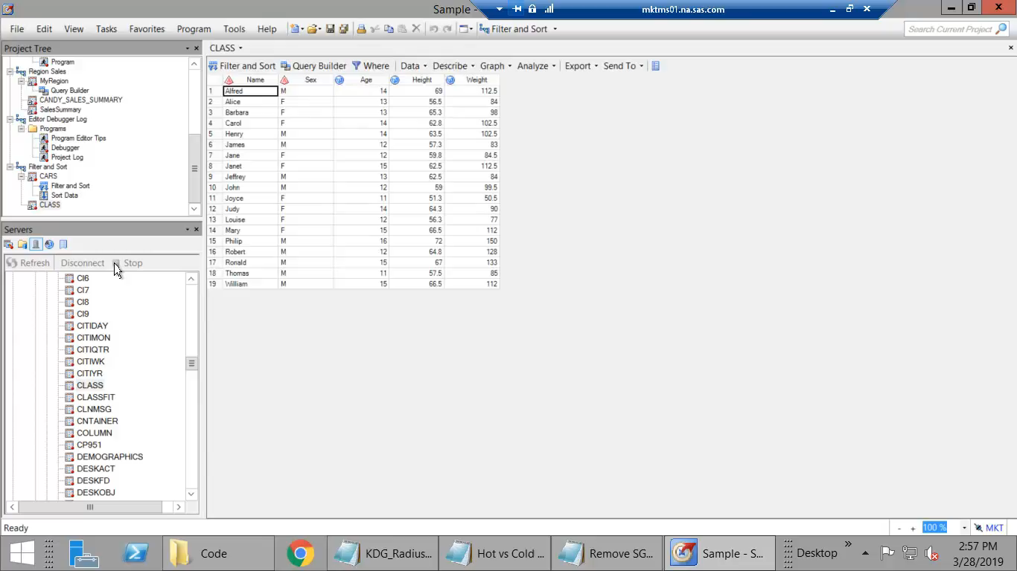
18. Create Dynamic Queries
Notes:
Create a macro variable that can be used in queries and code in the project
Create query that calculates avg height
Want to dynamically select gender of height to calc avg of
Use Prompt Manager to add new prompt
Name the prompt “gender”
Text prompt set to “Select a gender”
Select prompt type & values
Text
User selects from a static list – use the CLASS dataset to populate the list that they can choose from
Set a default (F)
Use the prompt in a query
Filter where sex= ……….select prompt from prompt tab
Run query
63.91 is avg height

Slide 26
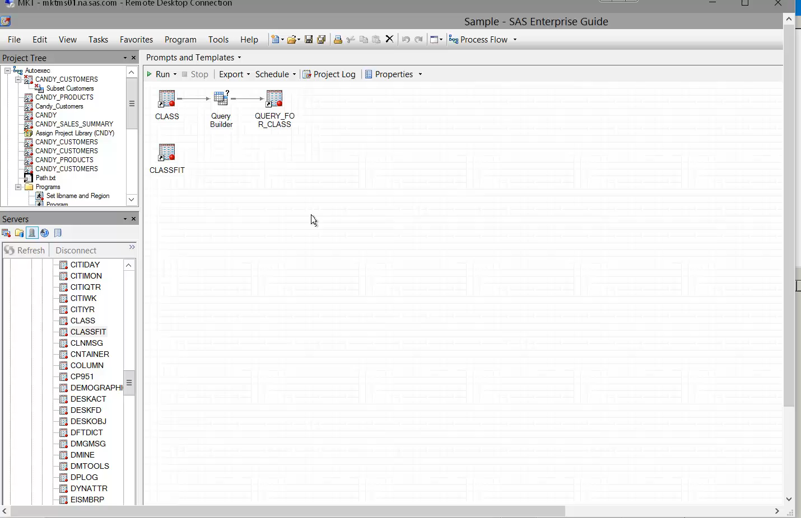
19. Create Task Templates and Subqueries
Notes:
Task Templates used when you run the same task often, lets you reuse instead of recreating each time
Subquery enables you to use results of one query within another without rerunning the first query
Create task template called “Avg Height” that we created in the prev slide, calculates the avg height of a specified gender
Query CLASSFIT table where height >=the height returned by the Avg Height template
NOTE: prompted for gender, so avg height is calculated for the selected gender
63.91 avg height
Query returns ALL people who have height >= that avg, regardless of their gender

Slide 27
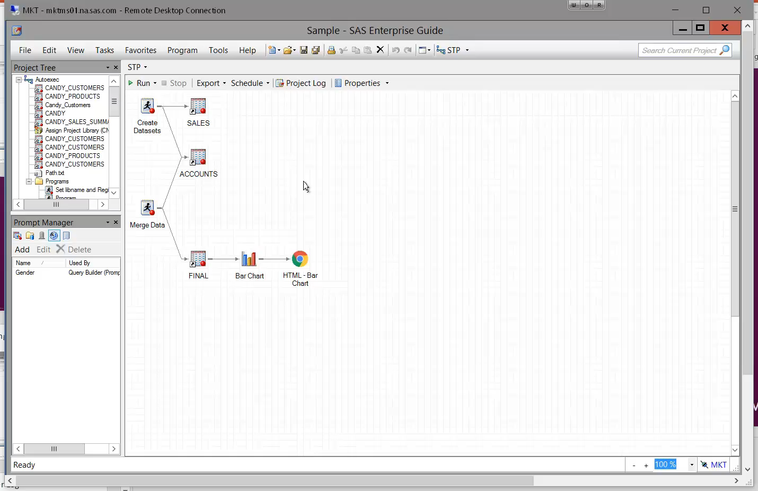
20. Create Stored Process
Notes:
Can easily create a stored process from project or process flow
STP puts all the code from the project into a bundle and stores it in a central location where it can be accessed by remote clients
Right click, select “Create stored process”
Give stp a name
Step through the wizard
Can view all the code from the project that will be included in the stp
Choose where to execute the stp
Run the stp

Slide 28
We made it!

Slide 29
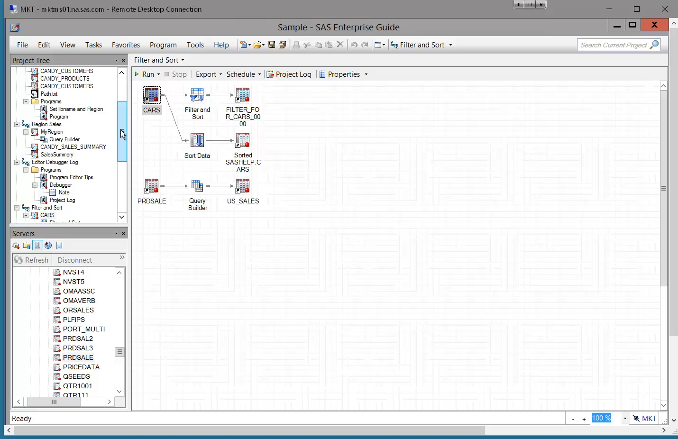
Bonus Tip: Search Project

Slide 30
Thank you!
Kelly Gray Kelly.Gray@sas.com
Reminder: Complete your session survey in the conference mobile app.

Slide 31


